Slide 1
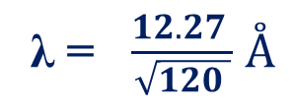
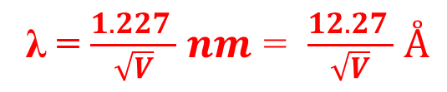
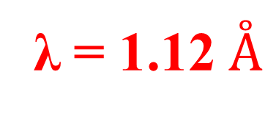
Dual Nature of Radiation Problems
Calculate the de-Broglie wavelength of an electron accelerated through a potential of 120 Volts
Solution:
Data given Accelerating potential V= 120 V
To find the de-Broglie wavelength of electron λ=?
de-Broglie wavelength of electron for an accelerating electron is given by
λ = $\frac{1.227 }{\sqrt{V}}$ $nm$ = $\frac{12.27 }{\sqrt{V}}$ $Å$
λ = $\frac{12.27 }{\sqrt{120 }}$ $\overset{̊}{A}$
λ = 1.12 $\overset{̊}{A}$

Slide 2

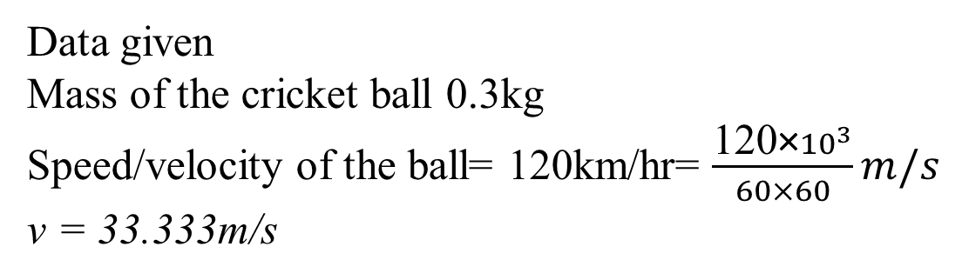
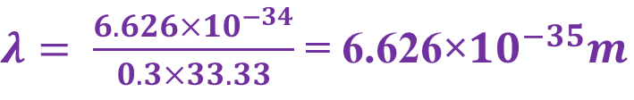
2. Calculate the de-Broglie wavelength of a 0.3 kg cricket ball with a speed of 120km/hr
Solution:
Data given
Mass of the cricket ball 0.3kg
Speed/velocity of the ball= 120km/hr= $\frac{\text{120}\text{×}{10}^{3}}{60×60}m/s$
v = 33.333m/s
To find the de-Broglie wavelength of electron λ=?
de-Broglie wavelength of cricket ball moving with a velocity of 120 km/hr is given by
$$λ= \frac{h}{mv}$$
$λ= \frac{6.626×{10}^{−34}}{0.3×33.33}$ = 6.626×${10}^{−35}m$

Slide 3
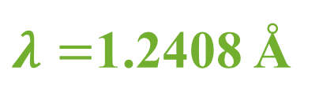
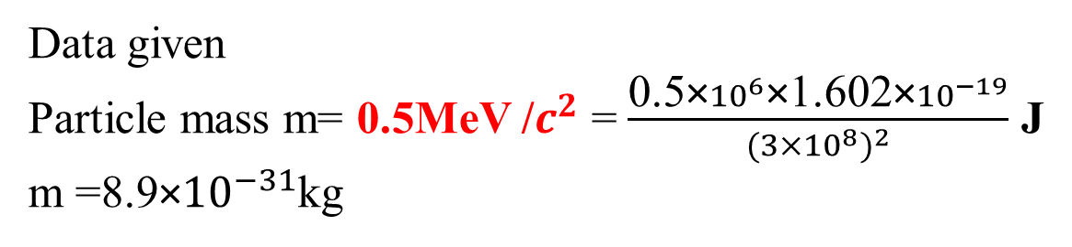
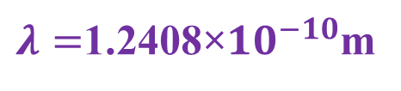
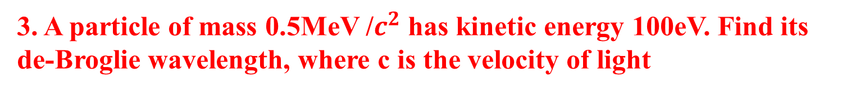
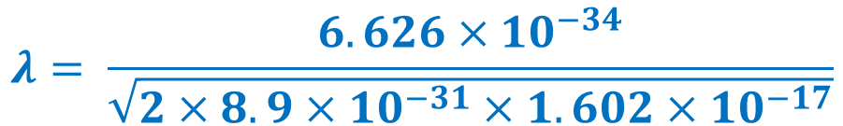

3. A particle of mass 0.5MeV /$c^{2}$ has kinetic energy 100eV. Find its de-Broglie wavelength, where c is the velocity of light
Solution:
Data given
Particle mass m= 0.5MeV /$c^{2}$ = $\frac{\text{0.5}\text{×}{10}^{6}\text{×}\text{1.602}\text{×}{10}^{−19}}{{(3×{10}^{8})}^{2}}$ J
m =8.9×${10}^{−31}$kg
Kinetic energy E= 100eV= $100×1.602×{10}^{−19}J=1.602×{10}^{−17}$J
de-Broglie wavelength of electron when kinetic energy is given is given by
$$λ= \frac{h}{\sqrt{2mE}}$$
$$λ= \frac{6.626×{10}^{−34}}{\sqrt{2×8.9×{10}^{−31}×1.602×{10}^{−17}}}$$
$λ=$1.2408×${10}^{−10}$m
$λ=$1.2408 Å

Slide 4
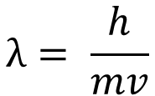
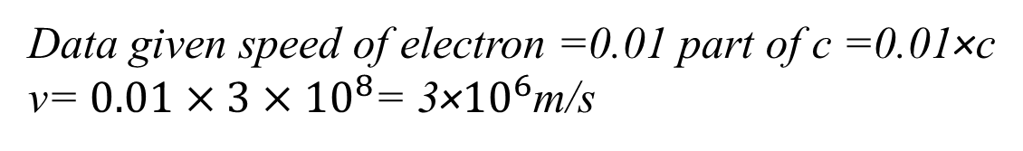
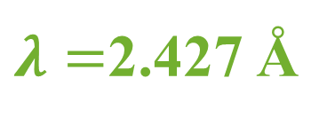
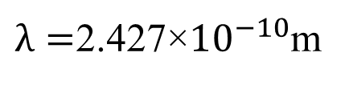
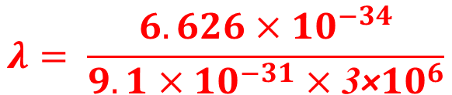
4. Calculate the wavelength associated with electrons whose speed is 0.01 part of the speed of light.
Solution:
Data given speed of electron =0.01 part of c =0.01×c
v= $0.01×{3×10}^{8}$= 3×${10}^{6}$m/s
To find wavelength of electrons
de-Broglie wavelength of electron with a speed of 0.01 part of “c”
$$λ= \frac{h}{mv}$$
$$λ= \frac{6.626×{10}^{−34}}{9.1×{10}^{−31}×\text{3}\text{×}{10}^{6}}$$
$λ=$2.427×${10}^{−10}$m
$λ=$2.427 Å

Slide 5
5. A particle of mass 0.65MeV/$c^{2}$ has a kinetic energy 80eV. Calculate the de-Broglie wavelength, group velocity and phase velocity of the de-Broglie wave
Solution:
Data given
Particle mass m= 0.65MeV /$c^{2}$ = $\frac{\text{0.65}\text{×}{10}^{6}\text{×}\text{1.602}\text{×}{10}^{−19}}{{(3×{10}^{8})}^{2}}$ J
m =1.157×${10}^{−30}$kg
Kinetic energy E= 80eV= $80×1.602×{10}^{−19}J=1.2816×{10}^{−17}$J
de-Broglie wavelength of electron when kinetic energy is given is given by
$$λ= \frac{h}{\sqrt{2mE}}$$
$$λ= \frac{6.626×{10}^{−34}}{\sqrt{2×1.157×{10}^{−30}×1.2816×{10}^{−17}}}$$
$λ=$1.2167×${10}^{−10}$m
$λ=$1.2167 Å

Slide 6
Group velocity and phase velocity of the de-Broglie wave is
group velocity is same as particle velocity then we can write
$v_{g}$ = $\frac{dω}{dk}=v_{particle }$
$$λ= \frac{h}{mv}$$
Since ${v_{group}=v}_{particle }$
$v_{group}= \frac{h}{m λ}$ = $\frac{6.626×{10}^{−34}}{1.157×{10}^{−30}×\text{1.2167}\text{×}{10}^{−10}}$
$v_{group}=$4.706× ${10}^{6}$m/s
phase velocity can be relate with group velocity and velocity of light as
$$v_{phase }=\frac{({3×{10}^{8})}^{2}}{\text{4}\text{.}\text{706}\text{× }{10}^{6}}$$
$$v_{g }v_{p }{=c}^{2}$$
$v_{phase }=$1.912×${10}^{10}m/s$
$$v_{phase }=\frac{c^{2}}{v_{group}}$$

Slide 7
6. Compare the energy of a photon with that of an electron when both are associated with Wavelength of 0.2 nm
Solution:
Data given wavelength of electron λ=0.2nm
To find energy of photon and electron
$$E=\frac{6.626×{10}^{−34}×3×{10}^{8}}{0.2×{10}^{−9}}$$
Energy of the photon $E=hγ=h\frac{c}{λ}$
$E_{photon}(E1)$ =9.939×${10}^{−16}$J =$\frac{\text{9.939}\text{×}{10}^{−16}}{\text{1.602}\text{×}{10}^{−19}}$ eV = 6.204×${10}^{3}$ eV
de-Broglie wavelength of electron when kinetic energy is given is given by
$$λ= \frac{h}{\sqrt{2mE}}$$
The energy of the neutron E_{electron} (E₂) can be written as
E_{electron} (E₂) = $\frac{h^{2}}{2mλ^{2}}$ =$\frac{{(6.626×{10}^{−34})}^{2}}{2×9.1×{10}^{−31}×{(0.2×{10}^{−9})}^{2}}$ = 6.031×${10}^{−18}$J =37.64 eV
$\frac{E_{photon}}{E_{electron}}$ = $\frac{\text{6.204}\text{×}{10}^{3}}{\text{37.64}}=164.69$

Slide 8
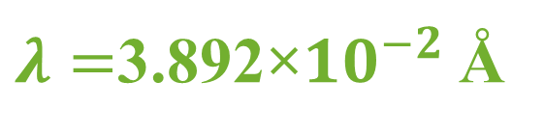
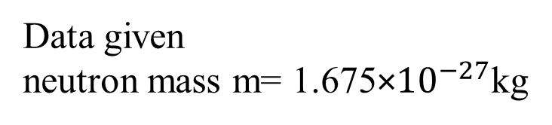
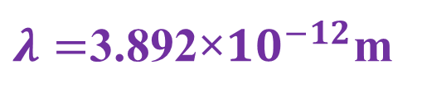
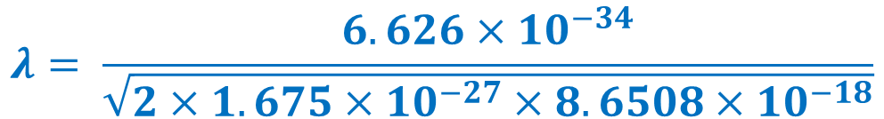
7. Calculate the de Broglie wavelength of a neutron moving with kinetic energy 54eV, given the mass of neutron=1.675$×{10}^{−27}$kg.
Solution:
Data given
neutron mass m= 1.675×${10}^{−27}$kg
Kinetic energy E= 54eV= $54×1.602×{10}^{−19}J=8.6508×{10}^{−18}$J
de-Broglie wavelength of electron when kinetic energy is given is given by
$$λ= \frac{h}{\sqrt{2mE}}$$
$$λ= \frac{6.626×{10}^{−34}}{\sqrt{2×1.675×{10}^{−27}×8.6508×{10}^{−18}}}$$
$λ=$3.892×${10}^{−12}$m
$λ=$3.892×${10}^{−2}$ Å

Slide 9
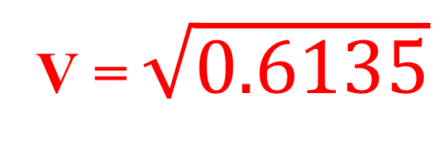
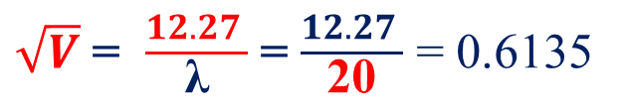
8. Estimate the potential difference through which an electron is needed to be accelerated so that its de Broglie wavelength becomes equal to 20 $\overset{̊}{A}$
Solution:
Data given de-Broglie wavelength of electron λ=20 $\overset{̊}{A}$
To find Accelerating potential V= ?
de-Broglie wavelength of electron for an accelerating electron is given by
λ = $\frac{1.227 }{\sqrt{V}}$ $nm$ = $\frac{12.27 }{\sqrt{V}}$ $Å$
$\sqrt{V}$ = $\frac{12.27 }{\text{λ}}$ = $\frac{12.27 }{\text{20}}$ = 0.6135
V = $\sqrt{\text{0.6135}}$
V = 0.783 V

Slide 10

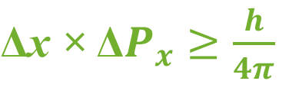
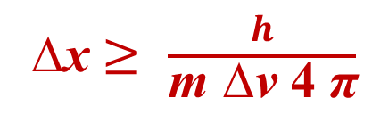
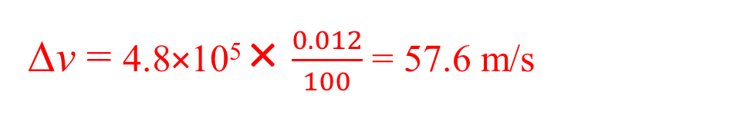
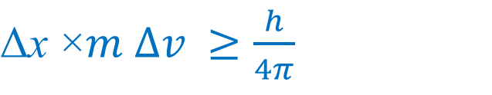
Quantum Mechanics Problems
1.An electron has a speed of 4.8×10⁵ m/s accurate to 0.012%. With what accuracy can be located the position of electron.
Solution
Here the data given is speed of the electron is v= 4.8×10⁵ m/s
Accuracy of speed is 0.012%
We need to calculate uncertainty in its position i e ∆x=?
By using Heisenberg’s Uncertainty Principle
$\text{Δ}\text{x}$ × Δ$P_{x}$ $≥\frac{h}{4π}$
Again P_{x}=m.v it is the momentum of the electron
$\text{Δ}\text{x}$ ×$m ∆v$ $≥\frac{h}{4π}$
$$∆p_{x}=m ∆v$$
∆v= v × accuracy of speed
∆v = 4.8×10⁵ × $\frac{0.012}{100}$ = 57.6 m/s
∆x $≥$ $\frac{h}{\text{m} \text{∆}\text{v} \text{4 }\text{π}}$
Substitute all the values of h, m, ∆v and π
∆x ≥ 1.007x10⁻⁶ m

Slide 11

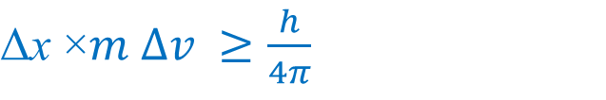
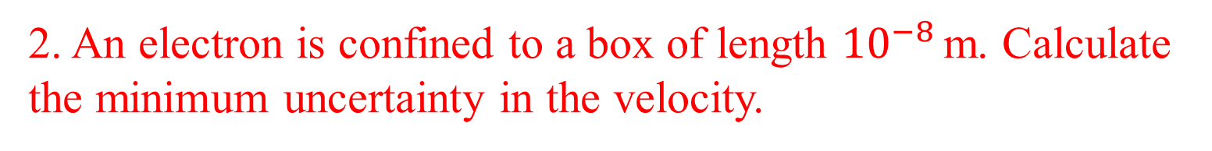


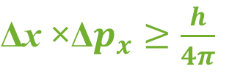

2. An electron is confined to a box of length ${10}^{−8}$ m. Calculate the minimum uncertainty in the velocity.
Solution
Here the data given is length of the box is x = ${10}^{−8}$ m
We need to calculate uncertainty in its velocity i e ∆v=?
$\text{Δ}\text{x}$ ×Δ$p_{x}$ $≥\frac{h}{4π}$
By using Heisenberg’s Uncertainty Principle
Again $p_{x}$= m.v it is the momentum of the electron
$\text{Δ}\text{x}$ ×$m ∆v$ $≥\frac{h}{4π}$
$$∆p_{x}=m ∆v$$
$∆v$ $≥\frac{h}{\text{Δ}\text{x}\text{ ×}m 4π}$
$∆v$ $≥$ $\frac{6.626×{10}^{−34}}{{10}^{−8}×9.1×{10}^{−31}×4×3.142}$
$∆v$ $≥5.794km/s$

Slide 12
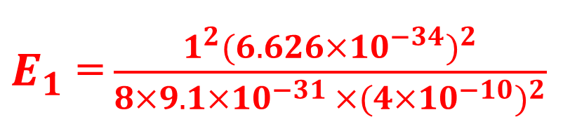
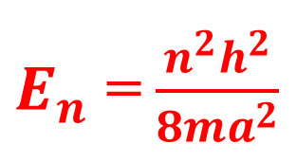
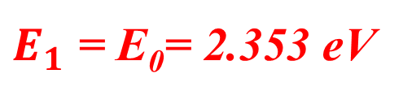
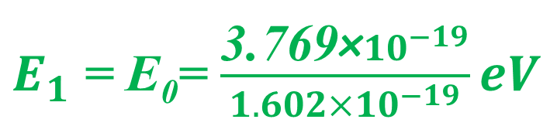
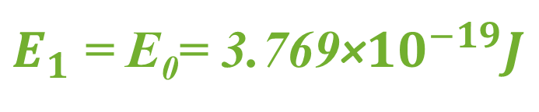
3. Calculate the first 3 permitted energy values for an electron in a box of width 4Å
Solution
We need to calculate the 3 permitted energy of electron when the box width is 4 Å
$E_{n}$ = $\frac{n^{2}h^{2}}{8ma^{2}}$
We have the energy Eigen value equation
Here n=1 for zero point energy, n=2 first exited energy, n=3 2nd exited energy state
h= Planck's constant 6.63×10⁻³⁴Js, m= mass of electron 9.1×10⁻³¹kg
a = width of the well= 4 Å = 4×10⁻¹⁰ m
$E_{1}$ = $\frac{1^{2}{(6.626×{10}^{−34})}^{2}}{8×9.1×{10}^{−31 }×{(4×{10}^{−10})}^{2}}$
$E_{1}$ = E₀= 3.769×${10}^{−19}J$
$E_{1}$ = E₀= $\frac{\text{3.769}\text{×}{10}^{−19}}{1.602×{10}^{−19}}eV$
$E_{1}$ = E₀= 2.353 eV

Slide 13
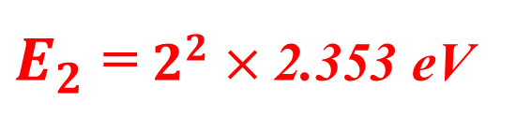
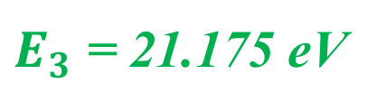
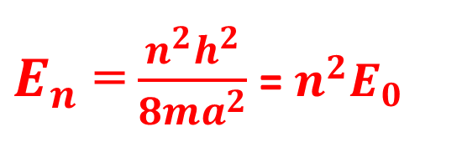
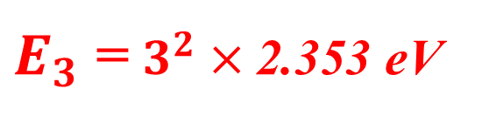
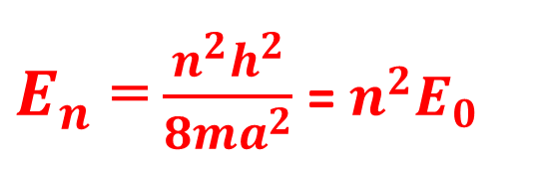
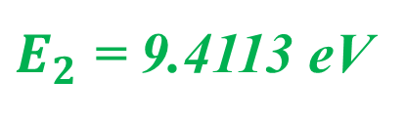
$E_{n}$ = $\frac{n^{2}h^{2}}{8ma^{2}}$ = $n^{2}E_{0}$
For n=2 first exited energy
$E_{2}$ = $2^{2}×\text{2.353 }\text{eV}$
$E_{2}$ = 9.4113 eV
$E_{n}$ = $\frac{n^{2}h^{2}}{8ma^{2}}$ = $n^{2}E_{0}$
For n=3 2nd exited energy state
$E_{3}$ = $3^{2}×\text{2.353 }\text{eV}$
$E_{3}$ = 21.175 eV

Slide 14
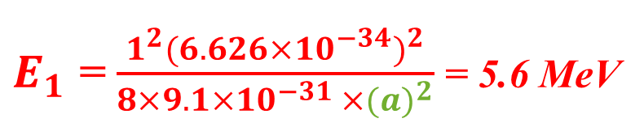

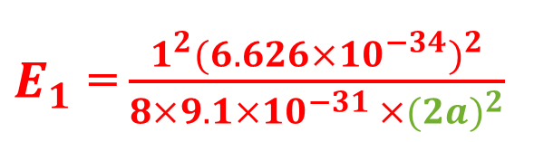
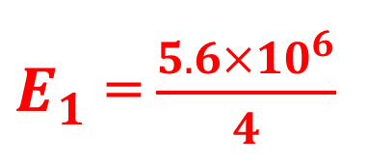
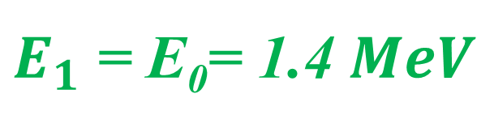
4. The ground state energy of an electron in an infinite well is 5.6MeV. What will be the ground state energy if the width of the well is doubled?
Solution
Given the data the ground state energy is 5.6MeV
We need to find what will be the ground state energy when its width is doubled so we need to substitute width as 2a instead of a
$E_{n}$ = $\frac{n^{2}h^{2}}{8ma^{2}}$
We have the energy Eigen value equation
Here n=1 for zero point energy
h= Planck's constant 6.63×10⁻³⁴Js, m= mass of electron 9.1×10⁻³¹kg
a = width of the well = 2a
$E_{1}$ = $\frac{1^{2}{(6.626×{10}^{−34})}^{2}}{8×9.1×{10}^{−31 }×{(2a)}^{2}}$
$E_{1}$ = $\frac{1^{2}{(6.626×{10}^{−34})}^{2}}{8×9.1×{10}^{−31 }×{(a)}^{2}}$ = 5.6 MeV
$E_{1}$ = $\frac{5.6×{10}^{6}}{4}$
$E_{1}$ = E₀= 1.4 $MeV$

Slide 15
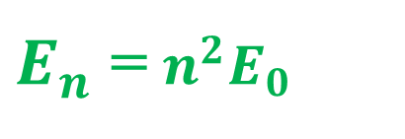
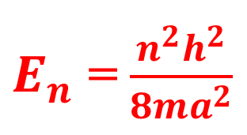
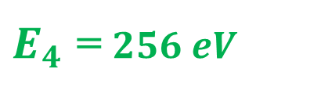
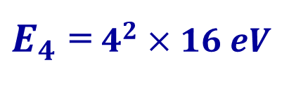
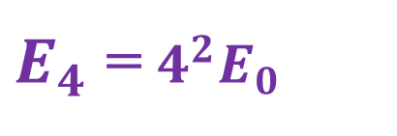
5. The ground state energy of an electron in a one dimensional infinite potential well of width 2Å is 16 eV. Calculate its energy in the third excited state.
Solution
Given the data the ground state energy is 16eV
We need to find what will be the third excited state energy when its width is a = 2Å
$E_{n}$ = $\frac{n^{2}h^{2}}{8ma^{2}}$
We have the energy Eigen value equation
Here n=4 for third excited state energy
$E_{n}$ = $n^{2}E_{0}$
$E_{4}$ = $4^{2}E_{0}$
$E_{4}$ = $4^{2}×16 eV$
$E_{4}$ = $256 eV$

Slide 16




6. Calculate the zero point energy for an electron in a box of width 10Å.
Solution
We need to calculate the zero point energy of electron when the box width is 10 Å
$E_{n}$ = $\frac{n^{2}h^{2}}{8ma^{2}}$
We have the energy Eigen value equation
Here n=1 for zero point energy
h= Planck's constant 6.63×10⁻³⁴Js, m= mass of electron 9.1×10⁻³¹kg
a = width of the well= 10 Å = 10 ×10⁻¹⁰ m
$E_{1}$ = $\frac{1^{2}{(6.626×{10}^{−34})}^{2}}{8×9.1×{10}^{−31 }×{(10×{10}^{−10})}^{2}}$
$E_{1}$ = E₀= 6.031×${10}^{−20}J$
$E_{1}$ = E₀= $\frac{\text{6.031}\text{×}{10}^{−20}}{1.602×{10}^{−19}}eV$
$E_{1}$ = E₀= 0.3765 eV

